Slide 1

WITCH ESCAPE
JAVADOC JUVENILES
VLADIMIR, SUBASH, RAJAN

Slide 2
AGENDA
GOAL/OBJECTIVE
INITIAL DESIGN
GAME DEMONSTRATION
CODE WALK THROUGH
CHALLENGES
LEARNING
STRETCH GOAL
Q/A

Slide 3
GOALS/OBJECTIVE
Apply the skills and knowledge acquired throughout this program and enhance a word-based game acquired from previous team.
Learn, adapt and apply agile principle during the game development.

Slide 4
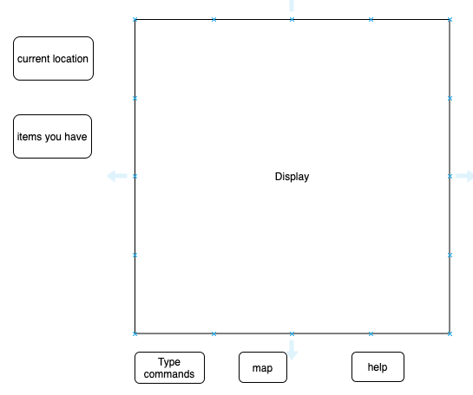
INITIAL DESIGN

Slide 5
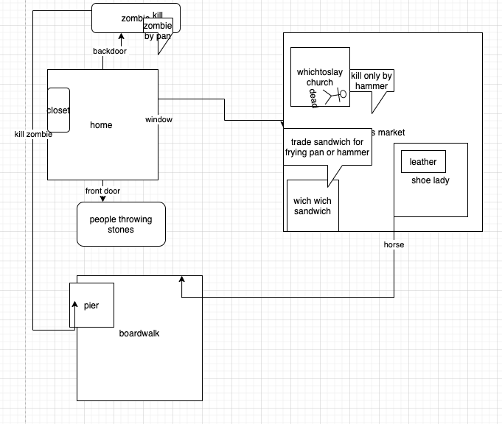
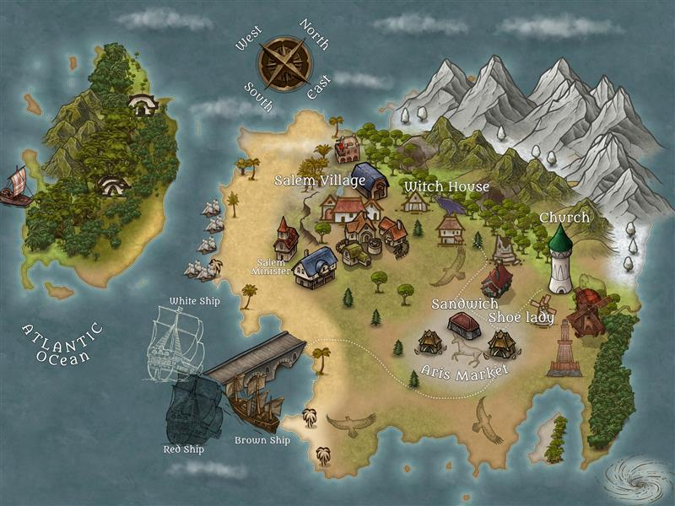
INITIAL DESIGN

Slide 6
GAME DEMO/CODE WALK-
THROUGH

Slide 7
CHALLENGES
Game Logic / Understanding the code from acquired project
Github
Relative File path (Jar)

Slide 8
LEARNING
Agile Principles
Game logic / better organization of code
Xml file parsing with object-oriented programming
Github
Gui
Relative File path
Regular Kanban board update

Slide 9
STRETCH GOAL
Navigation by clicking on the map
More validation
Volume control /slider

Slide 10
QUESTIONS ?

